Slide 1
CBR Radio Training
Disaster Preparedness and Management Unit
(Version 2.2; 13 April 2015)

Slide 2
Objective
To safely operate the radio inside the CBR suit

Slide 3
Radio - General
The radio is the Motorola DP4601; it is a digital radio. It is programed with three simplex channels that can be used for internal communication; Channel 15 remains as the CBR channel. Range is based on line of sight.
Radio Suite Components:
Radio (with battery and antenna)
Chest pack
Push to talk headset

Slide 4
Radio Data
Item | Specification
Frequency band | UHF
Channel capacity | 1000
Frequency band range | 403-527 MHz
Battery | IMPRES Hi-Cap Li-ion FM 2300 mAH Battery
Battery Life (5/5/90 duty cycle with carrier squelch and transmitter in high power) (1) | 17.3 hours
Power supply | 7.5 V (nominal)
Weight (with battery) | 365.5 g
Dimensions H x W x D (with battery) | 130.3 x 55.2 x 41.1 mm
Intrinsically safe (2) | Yes
Operating temperature | -30 ~ +60 °C
Storage temperature | -40° C / +85° C
Ingress rating | IP 57
Transmitter Low power output High power output | 1W 4W
Emergency button | Yes
GPS | Yes
Notes:
Notes:
The standard worldwide radio user application is referred to as a 5-5-90 Duty Cycle. This means users transmit (talk) 5% of the time, receive (listen) 5% of the time and are "on standby" 90% of the time.
A portable two-way radio that's labelled FM approved as Intrinsically Safe allows the user to safely operate that radio and battery in a hazardous location where the use of a standard two-way radio and battery is restricted. A hazardous location is defined as an area where fire/explosion hazard may exist due to the presence of one or more of the following: flammable gases, vapours, or liquids, combustible dust, ignitable fibres of flying particles. The following conditions must be met to ensure a radio is approved for operation in these hazardous environments:
the proper label must be on the approved portable two-way radio
the portable two-way radio must be used with a Motorola Factory Mutual Approved as Intrinsically Safe / non-incendive battery

Slide 5
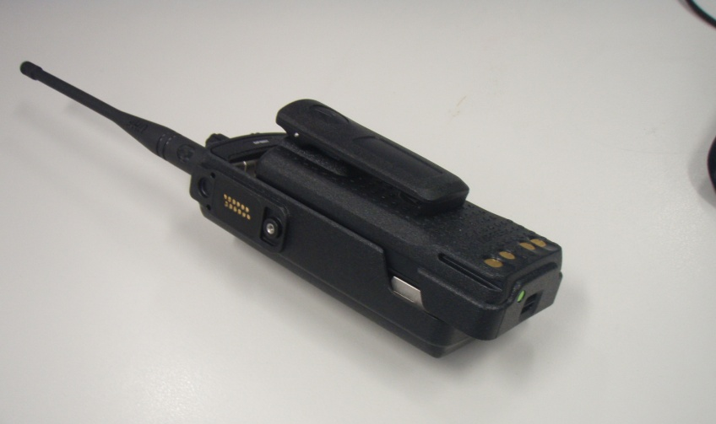
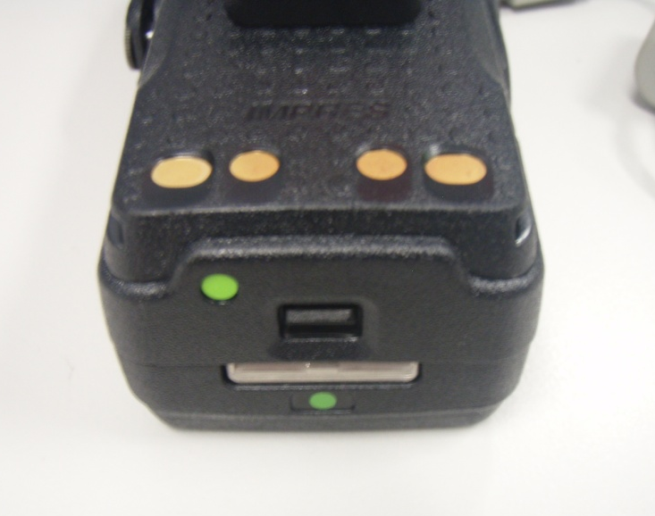
Attach battery and antenna
Locking lever
Notes:
Battery - Insert
The battery is attached by placing the battery onto the back of the radio approximately two third's along the length of the battery recess; it should naturally fall into recesses that allow the battery to engage the sliding mechanism . Once in place slide the battery from the base towards the top of the radio. A locking lug will engage (clicks in place) and secure the battery in position.: do a gently pull to ensure it is secure.
Once the battery is on ensure the radio operates correctly and the battery is fully charged (refer to slide 9)
Battery - Remove
At the base of the battery is a locking lever. To remove the battery push the lever up and then slide the battery back from the radio.
Antenna
The antenna screws into the top of the radio. Screw in until finger tight.

Slide 6
Radio - top
On/Off Volume
Universal connection port
Channel select
Notes:
For CBR operation ensure the radio is set to Zone – MERN and channel 15
To turn on rotate on/off volume knob anti clockwise.
To change channel rotate channel select knob. Channel numbers will appear on the screen. CBR is always channel 15.

Slide 7
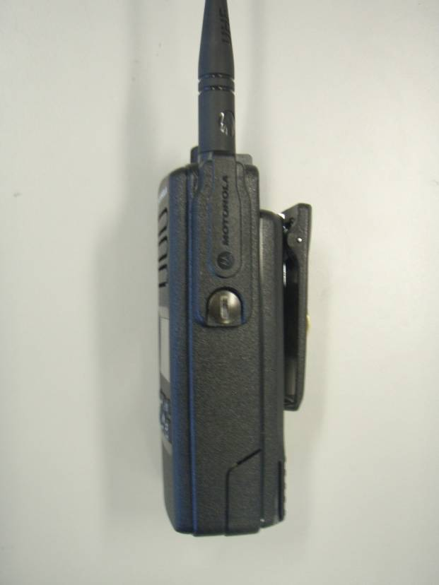
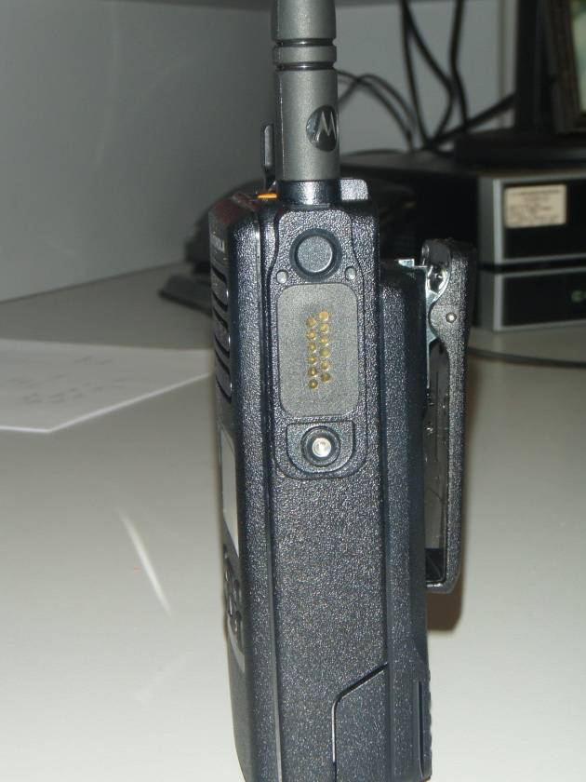
Radio – right side
Port cover on
Port cover off

Slide 8
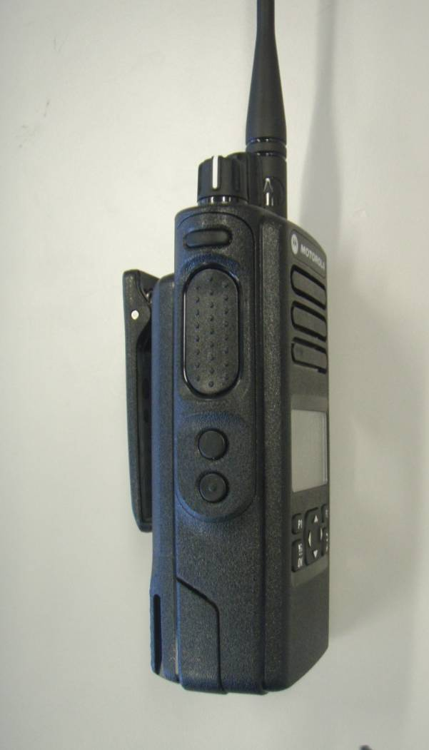
Radio – left side
Transmit button
Notes:
When using the radio in the hand held mode to talk the operator depresses the transmission button. This is not used when the radio is fitted with the headset (communication in this case is actuated by depressing a push to talk button that is part of the headset used in the CBR suit).

Slide 9
Radio - front
Universal connection port (under cover)
Battery level
Channel
Select
Menu
Notes:
For CBR operation ensure the radio is set to Zone – MERN and channel 15
To confirm zone:
Press the OK button. The screen will then display the Main Menus showing Contacts and Zone
Scroll down to Zone using the down arrow.
Press OK. The screen will then display MERN and Transportables.
The MERN title should have a tick against it.
If not, highlight the MERN title using the up/down arrows. Click OK. The screen should then display MERN selected with a tick.
To return to the original screen press the menu button

Slide 10
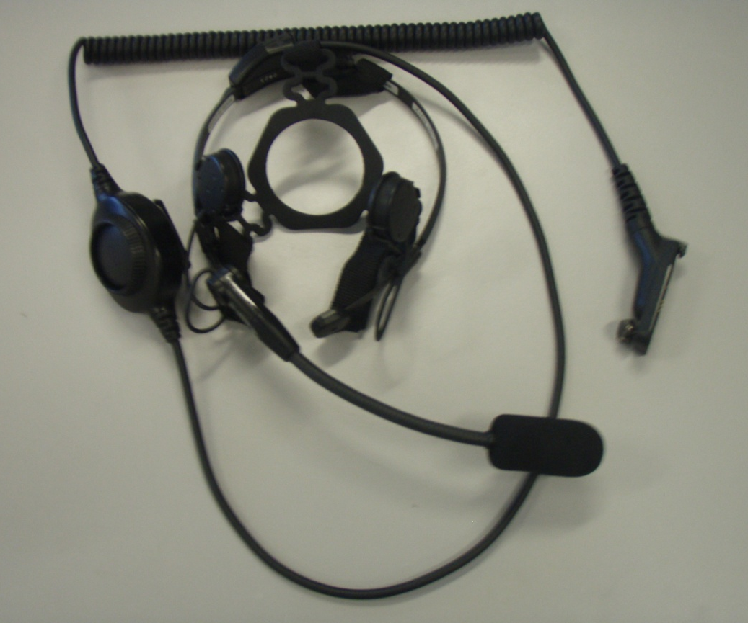
Push to talk (PTT) headset
Push to talk button
Radio connector
Boom microphone
Head piece with temple transducers
Notes:
The Push to Talk button is able to be clipped onto a strap or piece of clothing. It is surrounded by a protruding rim to prevent accidental activation of the radio.

Slide 11
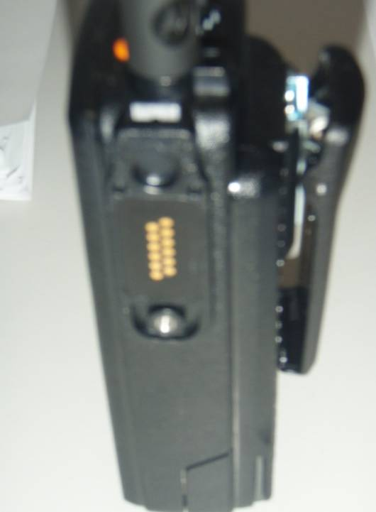
Attach PTT to the radio
1
Insert connector into recess on radio
2
Screw in connector
Radio with port cover removed
Notes:
There is a removable cover on the side of the radio. Remove the cover by rotating the lockdown screw anti clockwise; a 10 cent coin fits neatly in the groove in the screw.
Remove the cover. Retain the cover by placing it in a secure location.
Attach the connector that is on the end on the PTT Headset by engaging the top lug into a recess at the top of the radio above the port and then screw in connector to secure to radios.
After assembling conduct a radio test to ensure it is operational
Ensure the original port cover is placed back on after the PTT Headset is detached from the radio.
The port must be covered at all times to ensure the radio remains intrinsically safe.

Slide 12
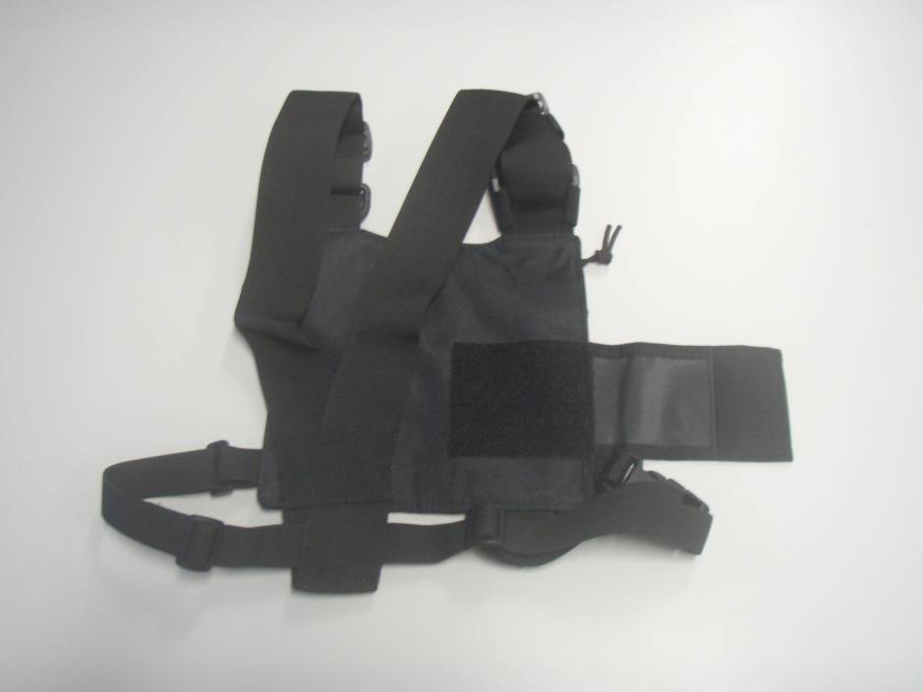
Chest pack (back)
Velcro adjustment for radio compartment
Notes:
When in the CBR suit the chest pack is worn on the back, The pack has adjustable straps for a snug fit on the operator.
The compartment that holds the radio is adjustable.

Slide 13
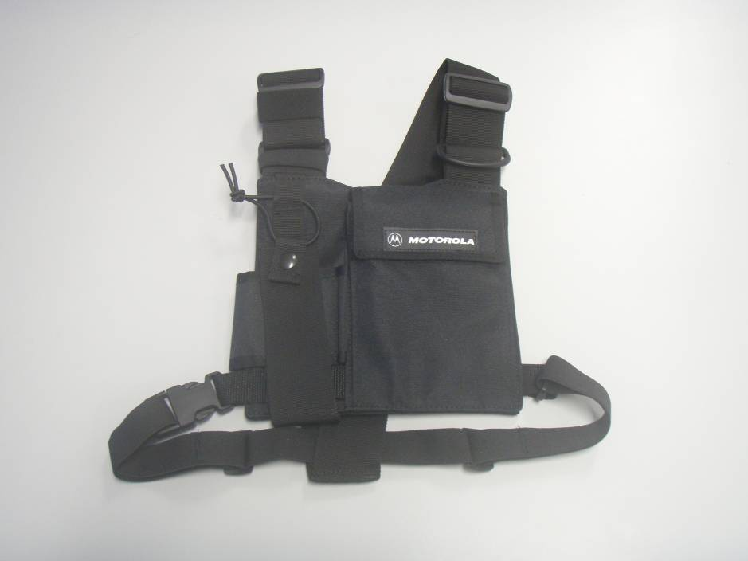
Chest pack (front)
Radio compartment

Slide 14
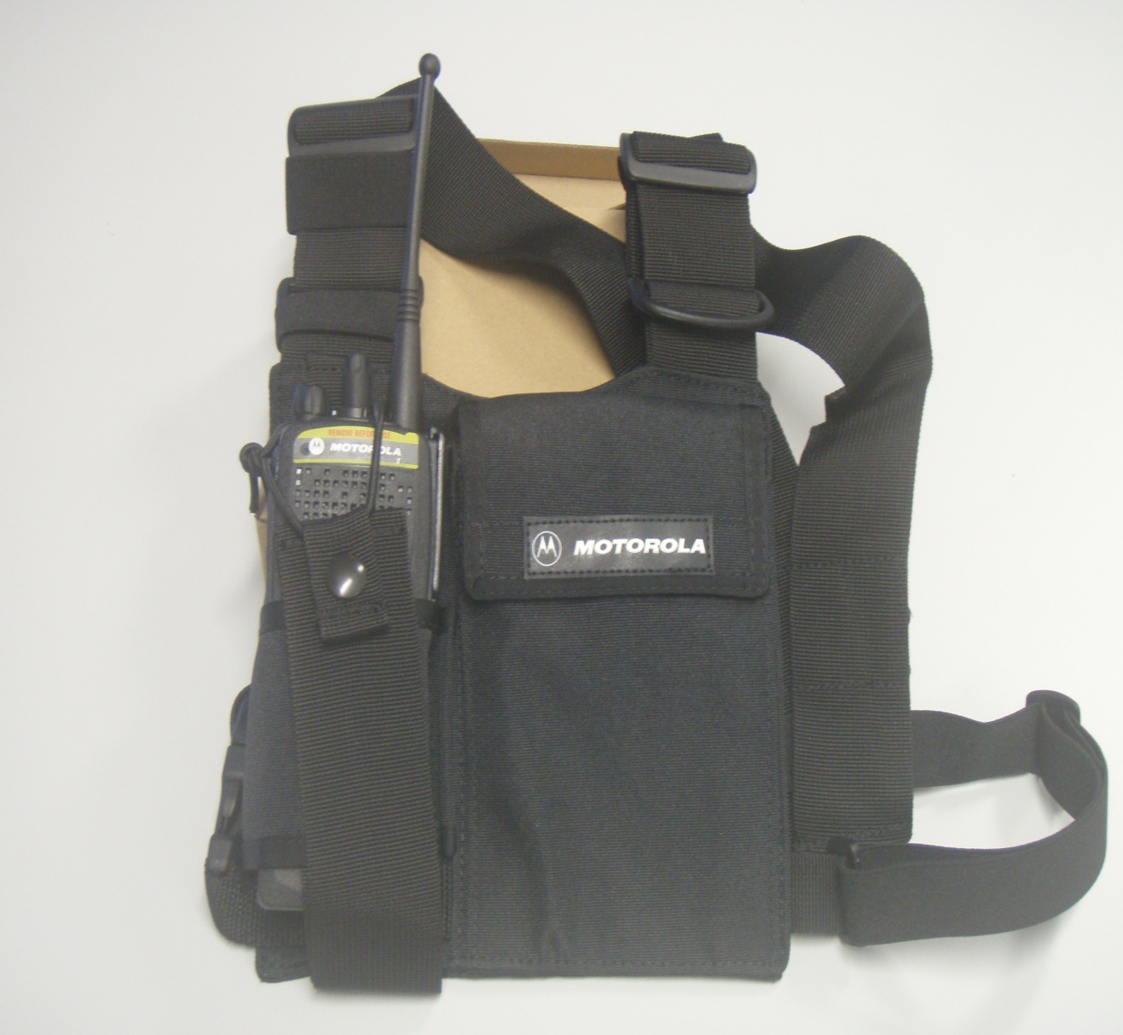
Chest pack with a radio inserted
Elasticized strap
Velcro adjustment strap
Notes:
Insert radio into the radio compartment; ensure the compartment is secure by adjusting the velcro strap. Secure the radio by pulling over the radio the elastic strap and secure(see above)

Slide 15
Fitting assembled radio - Steps
Assemble radio. Insert battery. Confirm channel setting. Test radio. Ensure volume to at least 3/4 strength.
Secure headset to the radio.
Place radio in chest pack, secure. Ensure cable from radio to headset passes under left arm. Ensure push to talk button is secure to clothing in chest area. Don headset. Conduct radio check.
Once suit is on conduct radio check.

Slide 16
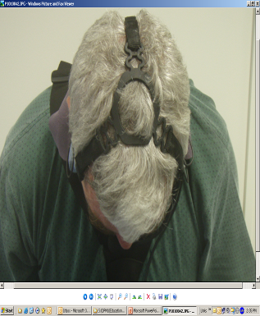
Fitting - headset
Temple transducers
Boom microphone
O Ring
Notes:
Place on headset.
Ensure the boom microphone is on your left hand side.
Place headset on head, have the ‘O ring’ located at the top of the skull.
Ensure transducers are against the skull in the vicinity of the temples.
Glasses can be worn with these headsets.

Slide 17
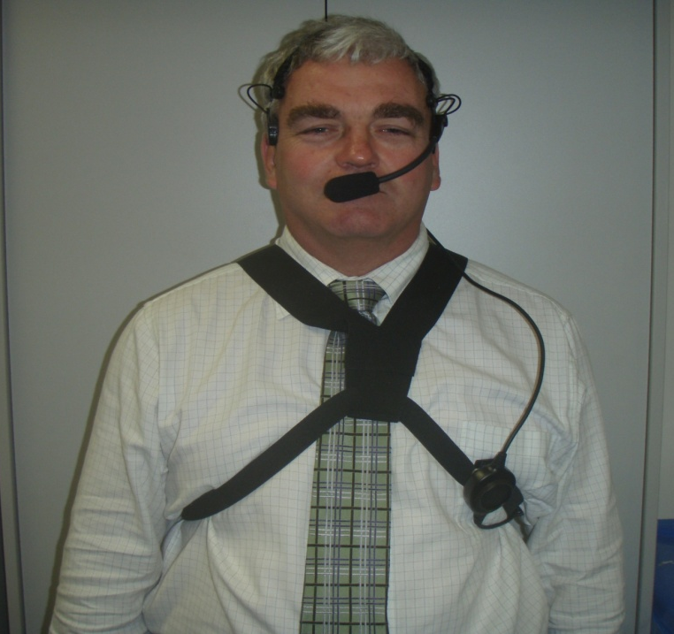
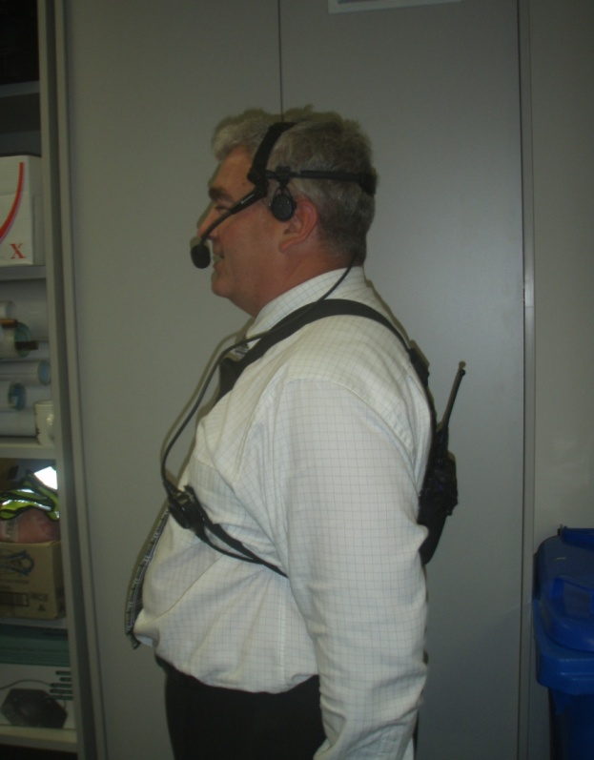
Fitting
Notes:
Adjust straps and place over body

Slide 18
Operate the radio
Feel for the PTT button.
Depress and hold the button to speak
Once you have finished speaking take hand off PTT button
The operator will be able to constantly hear other people speaking without having to depress the PTT button

Slide 19
Charging
Charging configuration options:
the radio with battery, or
the battery by itself
Ensure the radio is off
Ensure radio / battery is seated in the correct charging position in the charger
The charger will drain the battery and then refill with charge

Slide 20
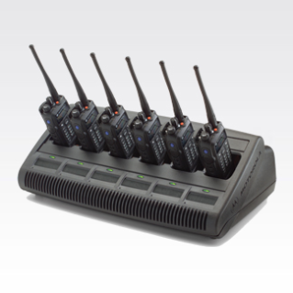
Charging (continued)
The radios should not be left in the charger once fully charged
Unless used the radios/batteries need not be charged more than once per month
Notes:
Motorola advises:
Leaving a battery in a device, in a cradle indefinitely will result in storing a battery with 100% charge. The battery will not be overcharged, but it will age quicker. If the device is not to be used for long periods of time, the device should not be stored in the cradle.
Batteries used beyond 300 charge /discharge cycles may not hold a charge as well as newer ones.

