Slide 1

Falls Risk Assessment and Management Plan
(FRAMP)

Slide 2
Outline of presentation
Revision process for the Falls Risk Management Tool (FRMT)
Overview of changes
Development of the FRAMP
Trial of the FRAMP
Evaluation of trial
How to use the Falls Risk Assessment and Management Plan (FRAMP)
Questions

Slide 3
Revision of FRMT
2010 FRMT introduced
2013 -14 FRMT revision - evaluated what worked well, what could be improved and made updates in line with best practice and NSQHS standards
Challenges
  Flow not always intuitive
  Screening process could be refined
  Some interventions could be clearer
  No capacity for additional input on form
  Requirement to go between FRMT and nursing care plan

Slide 4
Revision of FRMT
Thorough review process over 18 months
Started with survey of almost 500 nursing staff :-
    What was working?
    What wasn’t working?
Revised by a multidisciplinary, multi-site working party
Significant consultation process with clinical staff at all trial sites during development and feedback incorporated
Integration of NSQHS Standard 10 requirements
Assessment and interventions updated to reflect latest evidence and best practice

Slide 5
Overview of improvements
Screening process now in flow chart format
Interventions more specific and targeted
Referral to the form for shift by shift sign - rather than the nursing care plan
Designated space for multidisciplinary input
Space to easily record patient and carer:
  Education
  Involvement in the development of falls management plan
Everything in the one form - name changed to reflect this
  Falls Risk Assessment and Management Plan (FRAMP)

Slide 6
Trial of FRAMP
Trialled for 6 weeks
Bentley, Fremantle, SCGH and RPH
12 wards in total – 3 at each site
Evaluation via staff survey - 149 staff participated
Feedback incorporated
So….. what did staff say?

Slide 7
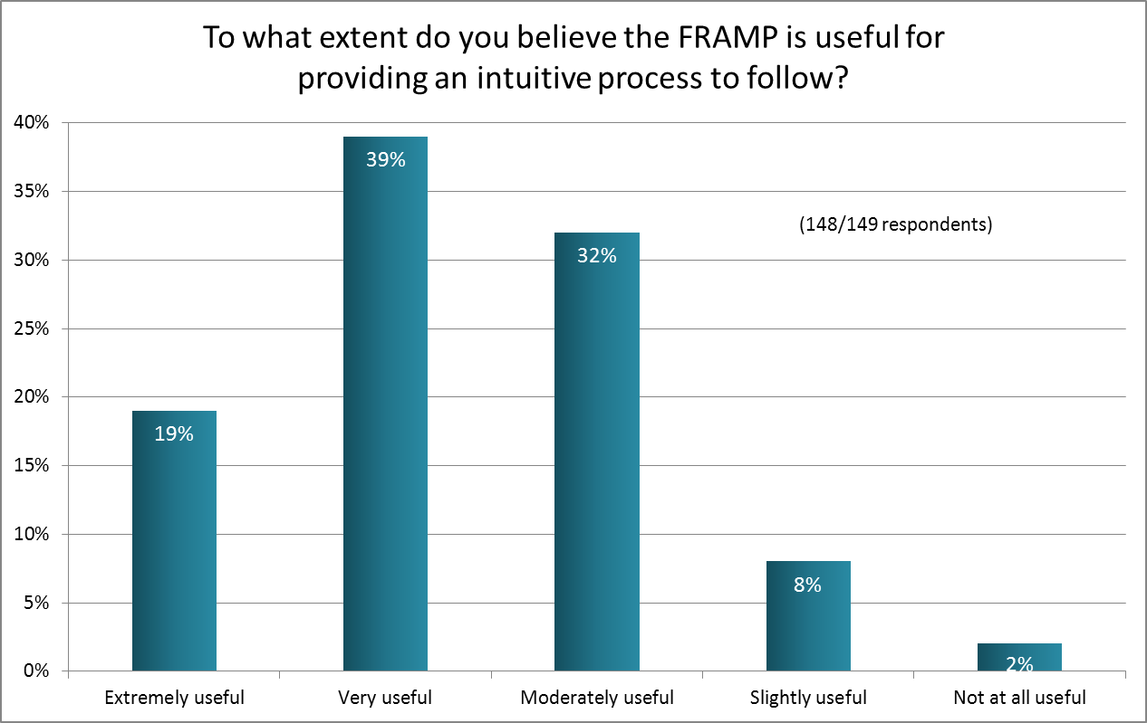
Provides an intuitive process?

Slide 8
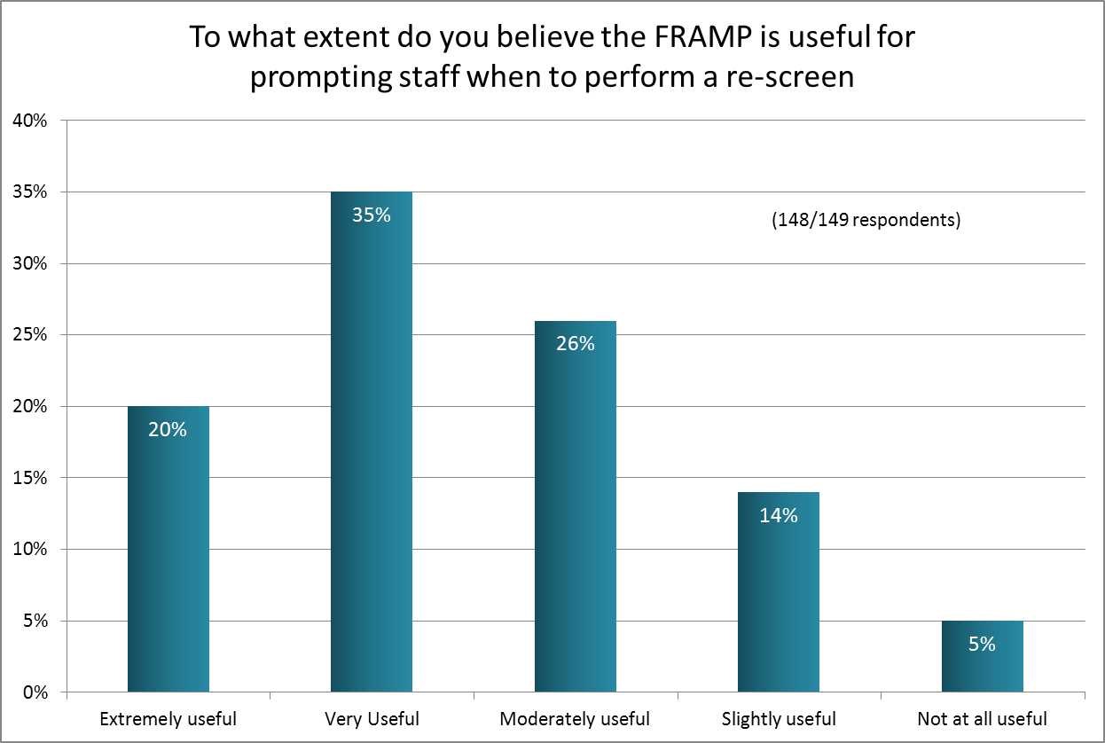
Prompts a re-screen?

Slide 9
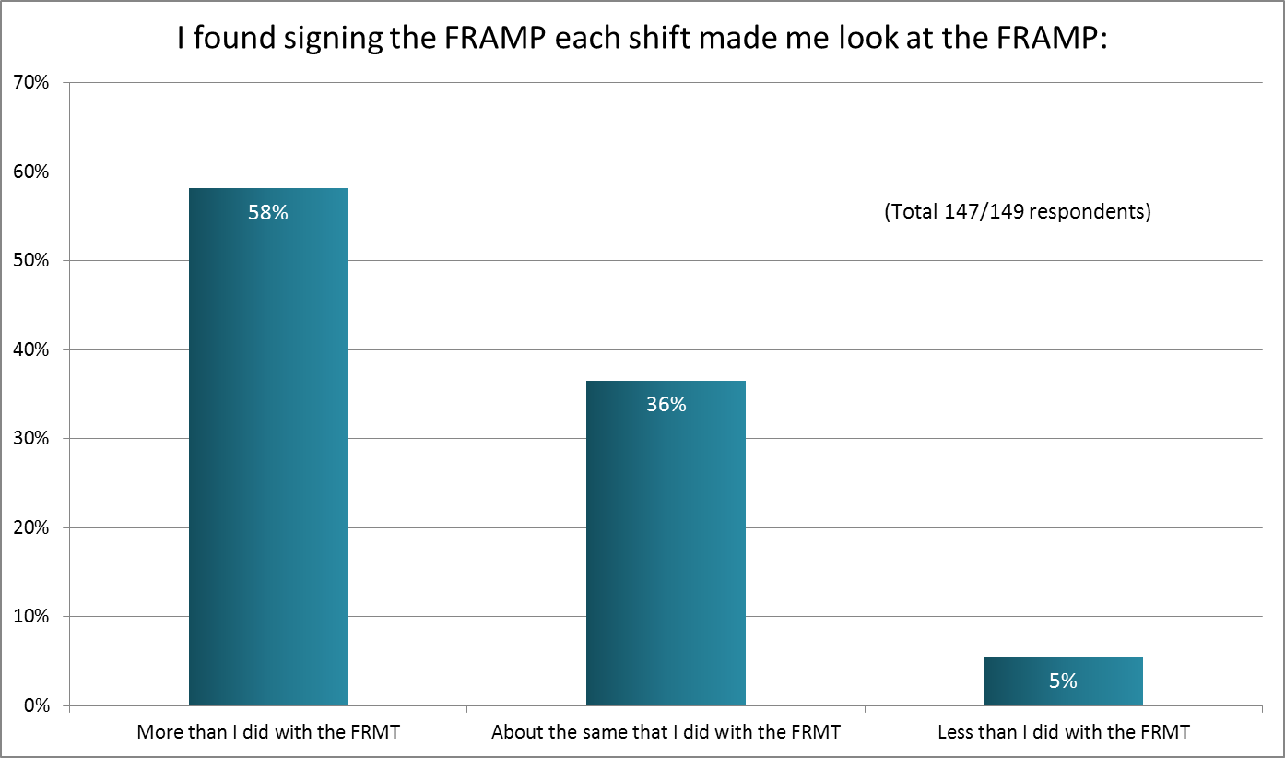
Impact of signing the FRAMP?

Slide 10
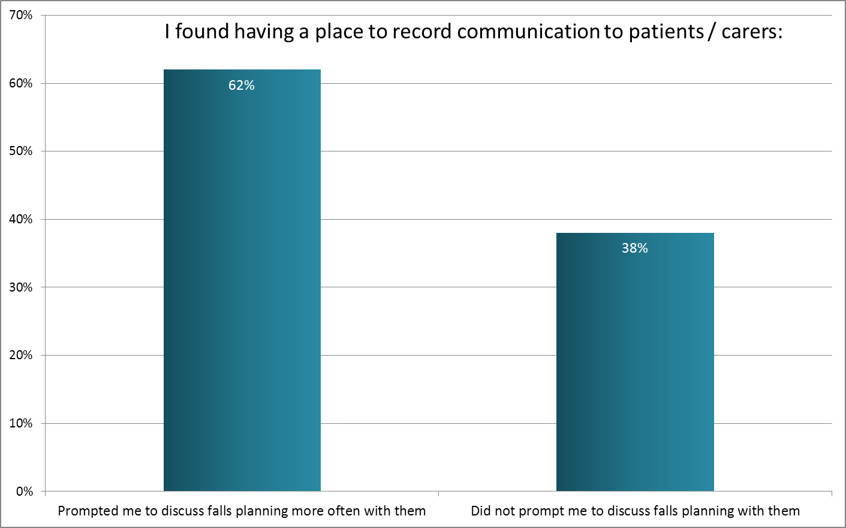
Improvements in patient / carer involvement?

Slide 11
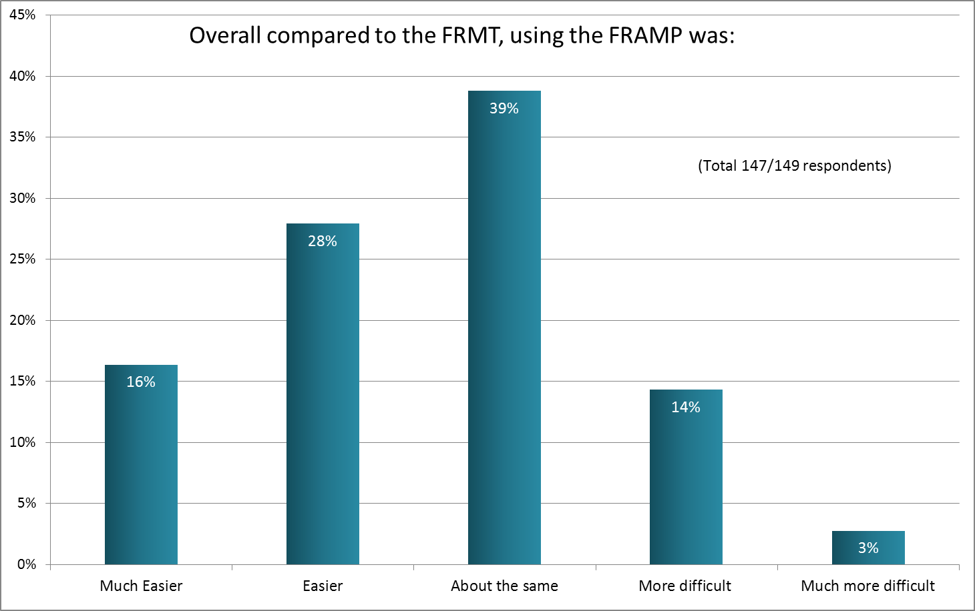
Direct comparison

Slide 12
Comments/Feedback
“Need More space to sign on the shift by shift check”
“There is more to read and more pages to fill out, however, the information on FRAMP is more detailed and is better for the patient. Is better to use for patient care.”
“Both are simple. FRAMP made me engage more with falls risk management of my patient”
Overall more positive feedback than negative!!
Note: Acceptability of the form was associated with education

Slide 13
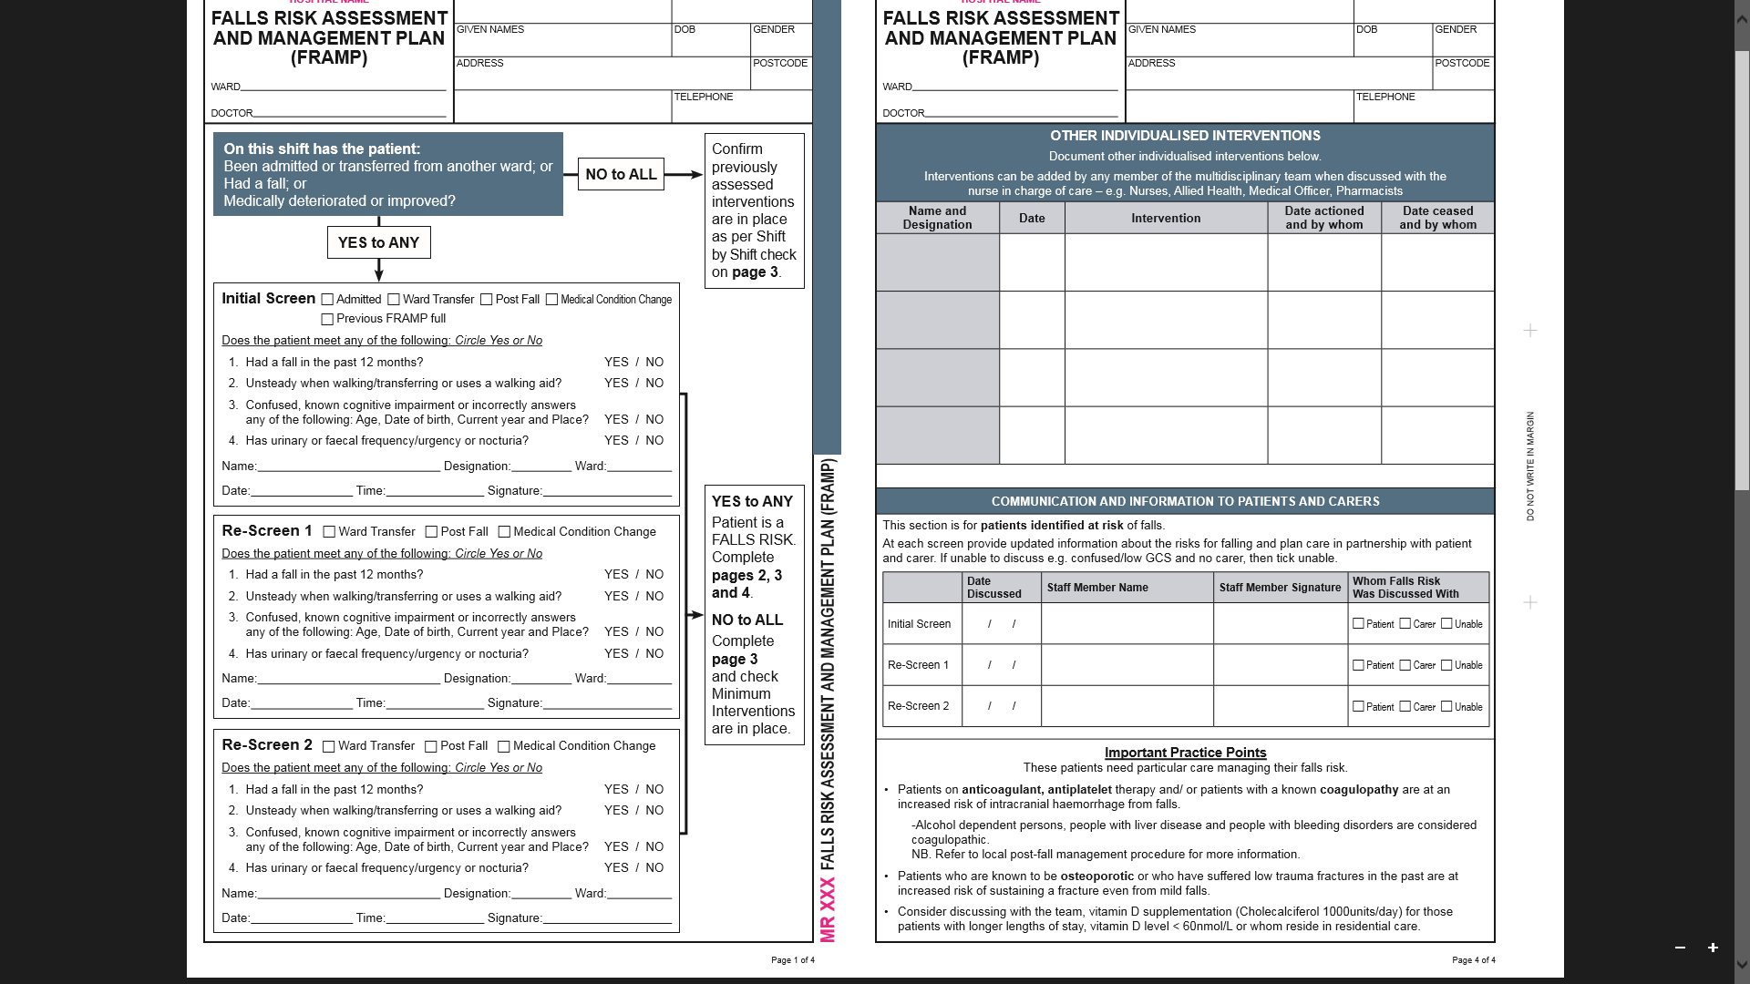
Screening Process (Page 1)
Step 1
Check for any change each and every shift
Step 2
If NO to all questions then turn to Page 3 where shift by shift sign is located
Step 3
If YES to any questions then proceed below to screen the patient

Slide 14
Screening Process (Page 1 cont.)
Step 1
Tick the box to indicate the reason for the screen
Step 2
Circle YES or NO for each of the four screening questions
Step 4
If the patient is a YES to ANY, complete pages 2,3 &4
NO to ALL, turn to page 3.
Step 3
Fill out your details

Slide 15
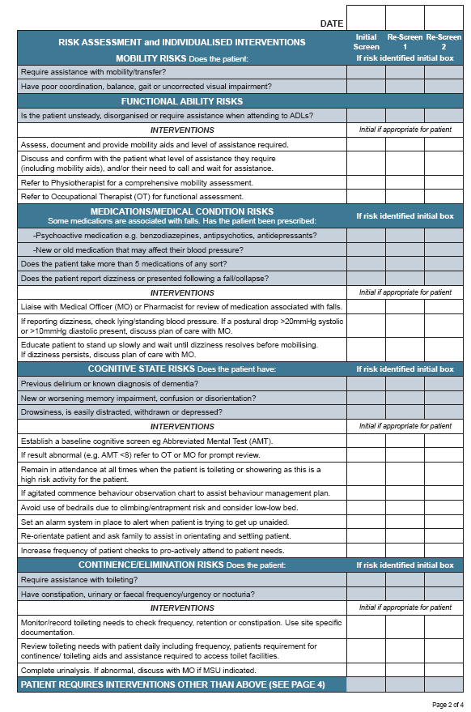
Risk Assessment and Individualised Interventions (Page 2)
Step 1
Assess the patients risk against the questions in the shaded area and initial all that apply
Step 2
Select Interventions to help manage the risks identified

Slide 16
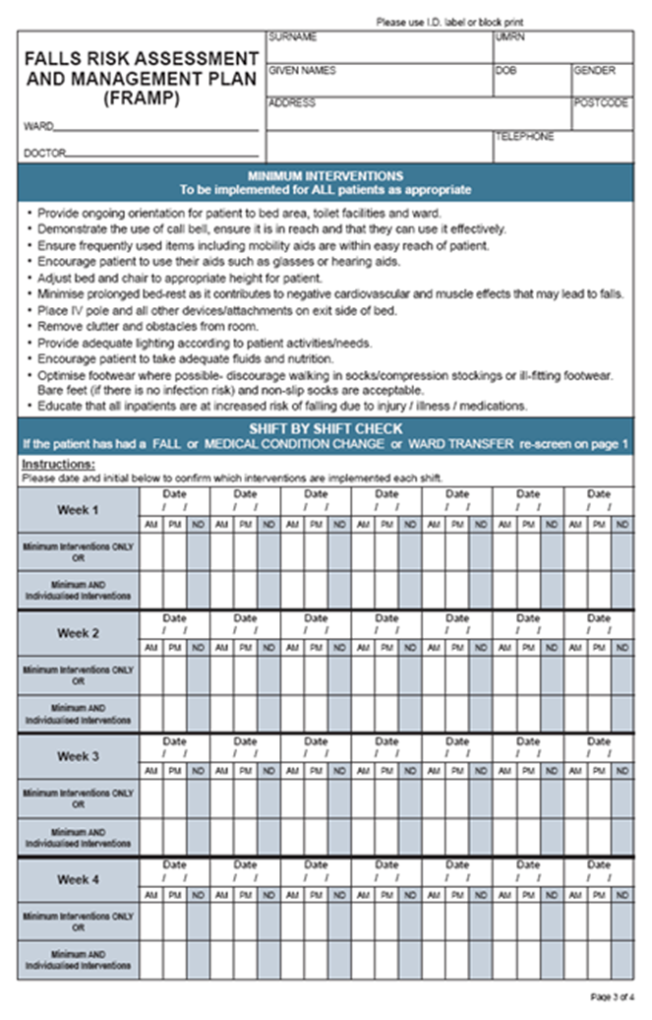
Minimum Interventions & Shift By Shift Check (Pg 3)
Step 1
Check all appropriate minimum interventions are in place for all patients
Step 2
Date and Initial for Minimum Interventions Only or for Minimum AND Individualised Interventions each shift

Slide 17
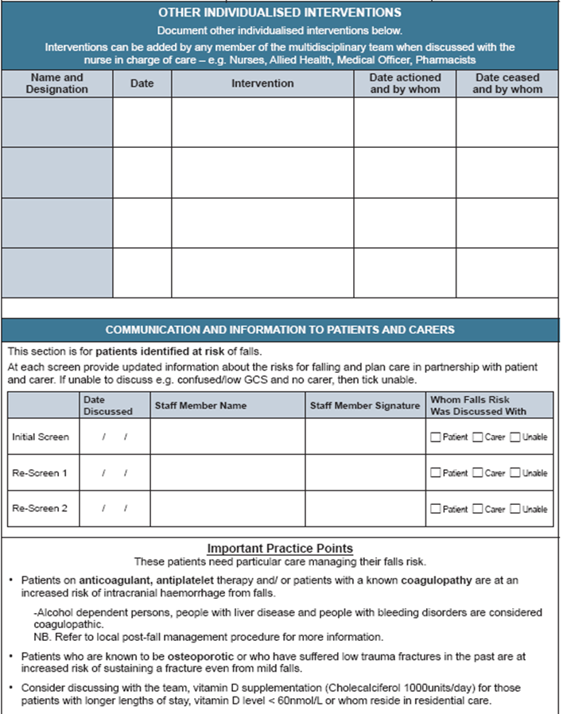
Other Individualised Interventions and Patient Engagement (Pg4)
Step 1
Any additional interventions from the team can be written here once discussed with the nurse
Step 2
For patients identified at risk discuss their risks and plan care together. Sign off when this is done.
Step 3
Know the important practice points

Slide 18
Conclusion
The FRAMP is a summary (and ready reference) of Australian best practice guidelines to reduce falls in hospital
Clinical staff were consulted prior to revising the FRMT, during development of FRAMP and after trial of the FRAMP
In a direct comparison of FRAMP Vs FRMT - FRAMP came out on top!
Majority of staff found the FRAMP either easier or about the same as the FRMT
Staff reported making significant positive changes to practice using the FRAMP

Slide 19
Questions?????????

