Slide 1
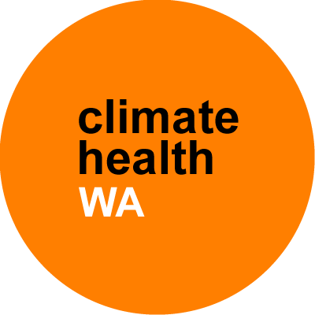
Climate Health WA
Public Forums
29 July to 20 August 2019
WA

Slide 2
The Inquiry
March 2019: State Government announced the Climate Health WA Inquiry
Aims:
  To investigate the implications of climate change for health in WA
  To develop a set of recommendations in line with the findings
w: health.wa.gov.au/climatehealthwa | e: climatehealthwa@health.wa.gov.au | t: @climatehealthwa

Slide 3
Recommendations from the Inquiry
Recommendations will address measures to:
Protect the public from the harmful health impacts of climate change
Support communities and health services to prepare for extreme weather events (focusing on the most vulnerable)
Reduce the health system’s contribution to climate change
Promote environmentally sustainable practices
w: health.wa.gov.au/climatehealthwa | e: climatehealthwa@health.wa.gov.au | t: @climatehealthwa

Slide 4
Adaptation vs. mitigation
Mitigation
Addresses the causes of climate change
Mitigation measures are those actions taken to reduce and curb greenhouse gas emissions
  e.g. reduced energy consumption from burning fossil fuels
Adaptation
Addresses the impacts of climate change
Adaptation measures are based on reducing vulnerability to the effects of climate change
w: health.wa.gov.au/climatehealthwa | e: climatehealthwa@health.wa.gov.au | t: @climatehealthwa

Slide 5
Inquiry process
Phase 1: Planning and set up
Phase 2: Public forums, public submissions
Phase 3: Formal hearings
Phase 4: Writing the report with recommendations
Due date: March 2020
w: health.wa.gov.au/climatehealthwa | e: climatehealthwa@health.wa.gov.au | t: @climatehealthwa

Slide 6
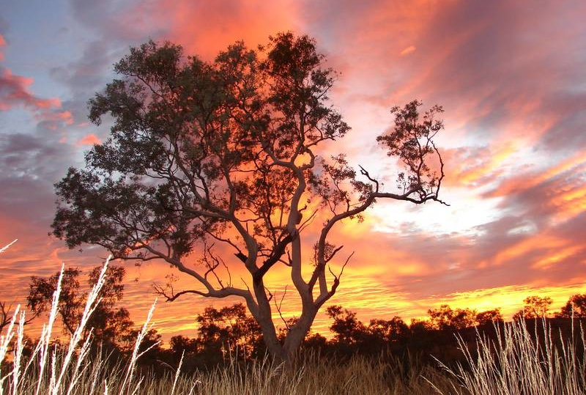
Climate change and health
w: health.wa.gov.au/climatehealthwa | e: climatehealthwa@health.wa.gov.au | t: @climatehealthwa

Slide 7
Weather vs. climate
Weather is what you’re experiencing at a particular place and time
Climate is the pattern of weather over time
Climate change is the change in weather patterns (climate) over long periods of time (decades or longer)
w: health.wa.gov.au/climatehealthwa | e: climatehealthwa@health.wa.gov.au | t: @climatehealthwa

Slide 8
The human influence on climate change
The unprecedented climate change we are experiencing is caused by the increase of greenhouse gases in the atmosphere
Greenhouse gases include carbon dioxide, methane, and nitrogen oxides
The increased amount of greenhouse gases is largely due to human activities such as:
  the burning of fossil fuels (coal, oil and natural gas)
  agriculture
  land clearing
w: health.wa.gov.au/climatehealthwa | e: climatehealthwa@health.wa.gov.au | t: @climatehealthwa

Slide 9
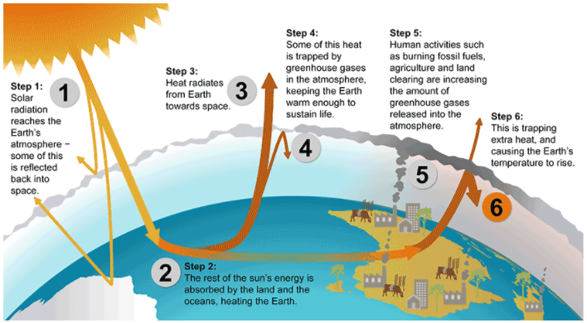
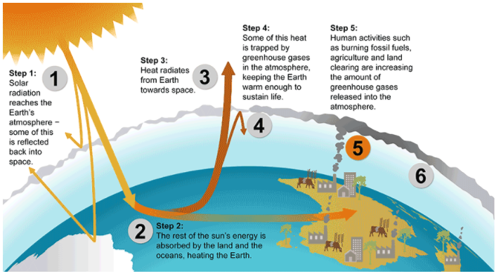
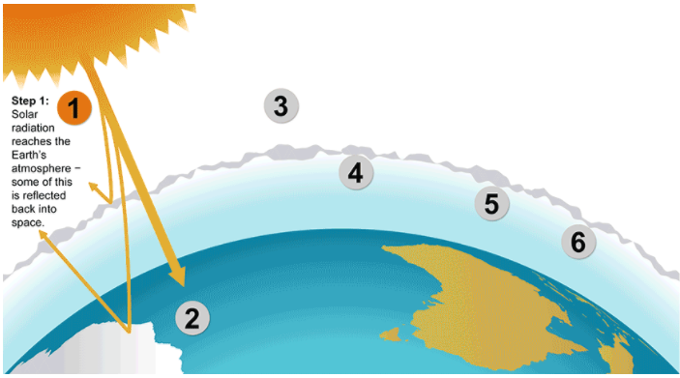
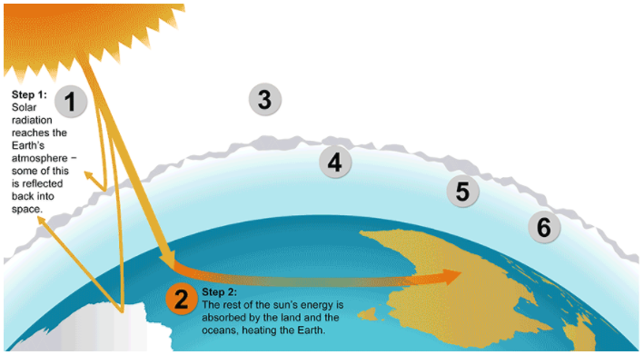
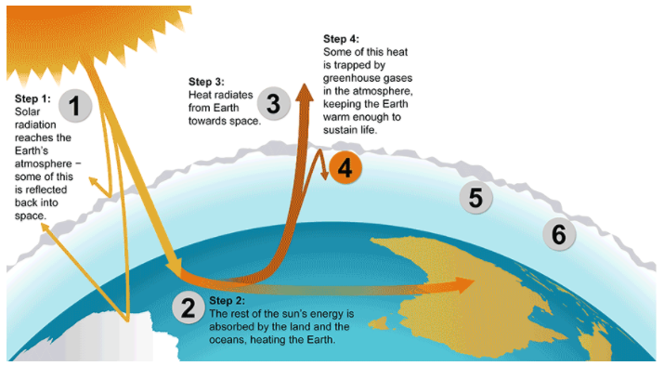
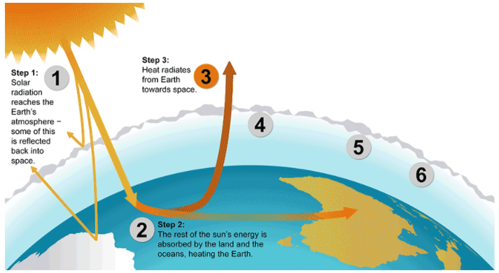
The greenhouse effect
Source: Australian Government, Department of the Environment and Energy (2019)
w: health.wa.gov.au/climatehealthwa | e: climatehealthwa@health.wa.gov.au | t: @climatehealthwa
Notes:
Reference: Australian Government, Department of the Environment and Energy
Greenhouse effect
https://www.environment.gov.au/climate-change/climate-science-data/climate-science/greenhouse-effect
Accessed: 25 July 2019

Slide 10
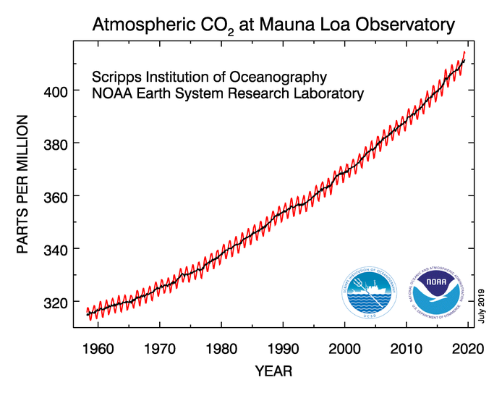
Greenhouse gas levels, Hawaii
1958: 313ppm 2018: 411ppm
Source: National Oceanic & Atmospheric Administration (NOAA), Earth System Research Laboratory (2019)
w: health.wa.gov.au/climatehealthwa | e: climatehealthwa@health.wa.gov.au | t: @climatehealthwa
Notes:
Reference: National Oceanic & Atmospheric Administration, Earth System Research Laboratory, Global Monitoring Division
Trends in Atmospheric Carbon Dioxide
https://www.esrl.noaa.gov/gmd/ccgg/trends/
Accessed: 26 July 2019

Slide 11
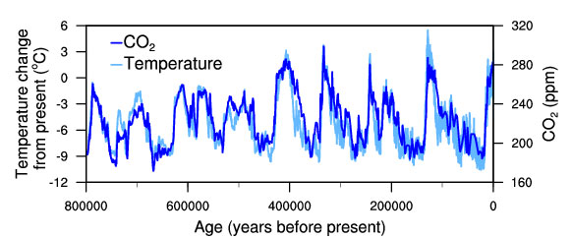
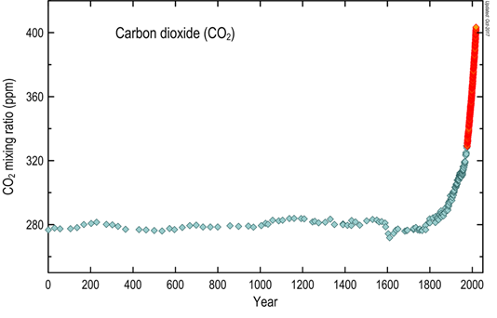
Temperature linked to CO₂: the glacial cycles of the past several hundred thousand years
[
Source: NOAA, National Centers for Environmental Information (2019)
Source: CSIRO (2019)
w: health.wa.gov.au/climatehealthwa | e: climatehealthwa@health.wa.gov.au | t: @climatehealthwa
Notes:
Reference 1: National Oceanic and Atmospheric Administration, National Centers for Environmental Information
Temperature Change and Carbon Dioxide Change
https://www.ncdc.noaa.gov/global-warming/temperature-change
Accessed: 25 July 2019
Reference 2: CSIRO
Latest Cape Grim greenhouse gas data
https://www.csiro.au/en/Research/OandA/Areas/Assessing-our-climate/Latest-greenhouse-gas-data
Accessed: 25 July 2019

Slide 12
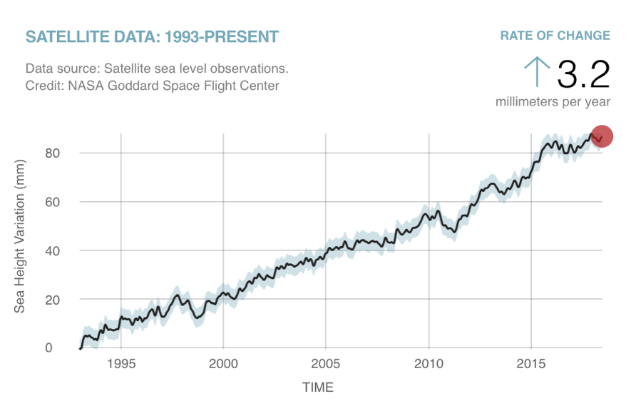
Rise in sea levels
Source: The Climate Reality Project (2018)
w: health.wa.gov.au/climatehealthwa | e: climatehealthwa@health.wa.gov.au | t: @climatehealthwa
Notes:
Sourced from NASA: Change in sea level since 1993 as observed by NASA satellites
Reference: The Climate Reality Project
Get the Facts: Why are sea levels rising?
Published 31 October 2018
https://www.climaterealityproject.org/blog/get-facts-why-are-sea-levels-rising
Accessed 26 July 2019

Slide 13
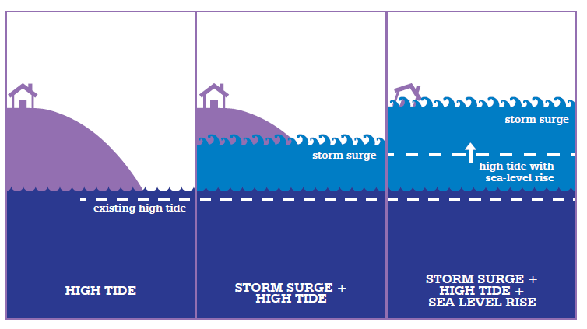
Coastal flooding
Rising sea level increases the base level for a storm surge
More coastal flooding
Source: Climate Commission, The Critical Decade (2013)
w: health.wa.gov.au/climatehealthwa | e: climatehealthwa@health.wa.gov.au | t: @climatehealthwa
Notes:
References: Climate Commission
The Critical Decade 2013: Climate Change Science, Risks and Responses
Climate Change Impacts for Western Australia
Available from: https://www.climatecouncil.org.au/resources/climate-change-impacts-for-western-australia/
Accessed: 25 July 2019

Slide 14
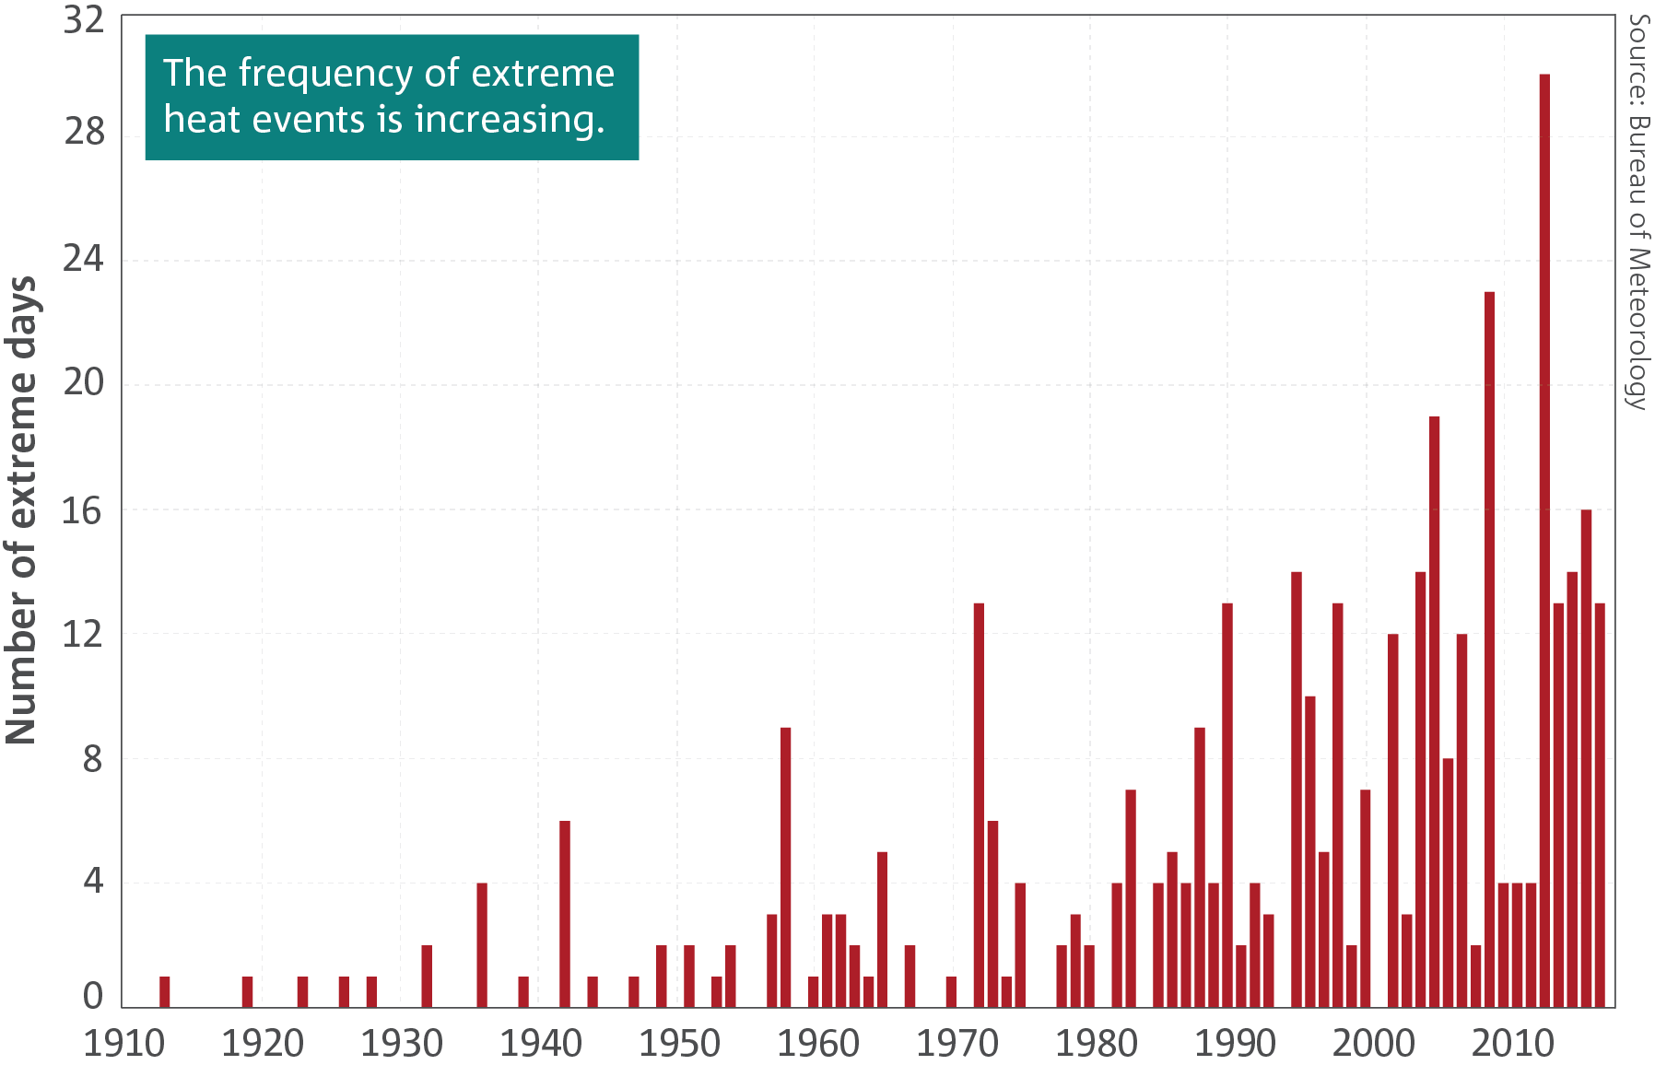
Australia’s rise in temperature
Australia is getting hotter (just over 1⁰C since 1910)
All seasons and both day and night temperatures affected
More extreme heat events
Extreme heat days are days where the temperature is greater than the 99th percentile of each month between 1910 and 2017
Source: CSIRO & Bureau of Meteorology, State of the Climate Report (2018)
w: health.wa.gov.au/climatehealthwa | e: climatehealthwa@health.wa.gov.au | t: @climatehealthwa
Notes:
Reference: CSIRO & Australian Government, Bureau of Meteorology
State of the Climate 2018
Australia’s changing climate (p4)
Report downloaded from: https://www.csiro.au/en/Showcase/state-of-the-climate
Accessed 25 July 2019

Slide 15
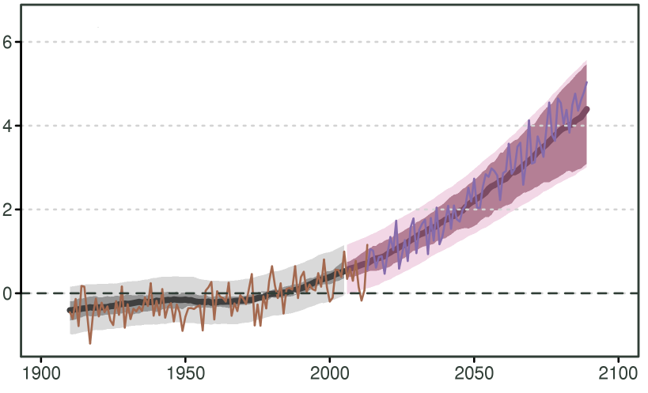
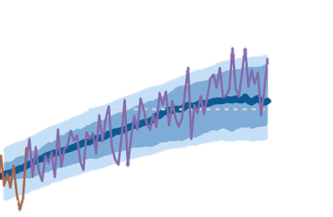
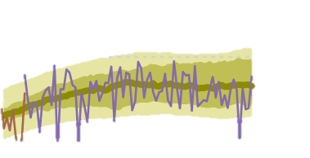
Emissions scenarios and Australia’s temperature rise
Source: CSIRO, Climate Change in Australia Technical Report (2015)
w: health.wa.gov.au/climatehealthwa | e: climatehealthwa@health.wa.gov.au | t: @climatehealthwa
Notes:
Paris agreement: still hit 3 degrees
Reference: CSIRO
Climate Change in Australia: Projections for Australia’s NRM Regions Technical Report (2015)
Available from: https://www.climatechangeinaustralia.gov.au/en/publications-library/technical-report/
Accessed: 25 July 2019

Slide 16
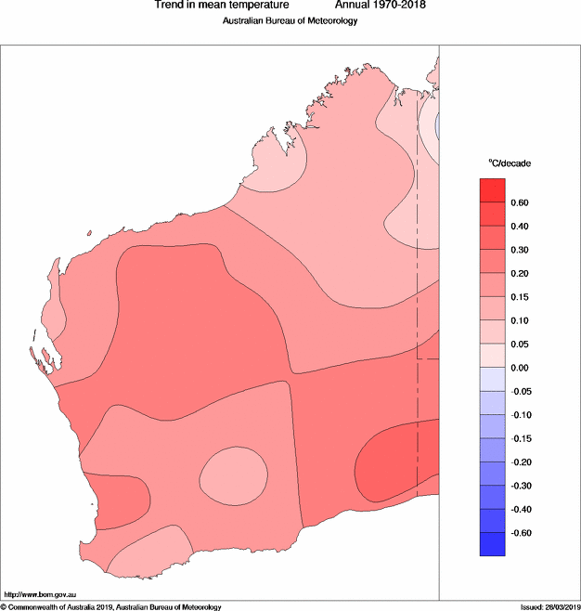
Temperature rise in WA: the past 40 years
Source: Bureau of Meteorology (2019)
w: health.wa.gov.au/climatehealthwa | e: climatehealthwa@health.wa.gov.au | t: @climatehealthwa
Notes:
40 years of change in temperature
Reference: Australian Bureau of Meteorology
Australian climate variability & change – Trend maps
Issued 26 March 2019
Available from: http://www.bom.gov.au/climate/change/#tabs=Tracker&tracker=trend-maps
Accessed: 26 July 2019

Slide 17
Levels of confidence in the predictions
Very high confidence in continued increases of mean, daily minimum and daily maximum temperatures throughout this century for all regions in Australia
Warming will be:
  large compared to natural variability in the near future (2030) (high confidence) and
  very large compared to natural variability late in the century (2090) under high emissions
  (very high confidence)
)
Source: CSIRO & Bureau of Meteorology, State of the Climate Report (2018
w: health.wa.gov.au/climatehealthwa | e: climatehealthwa@health.wa.gov.au | t: @climatehealthwa

Slide 18
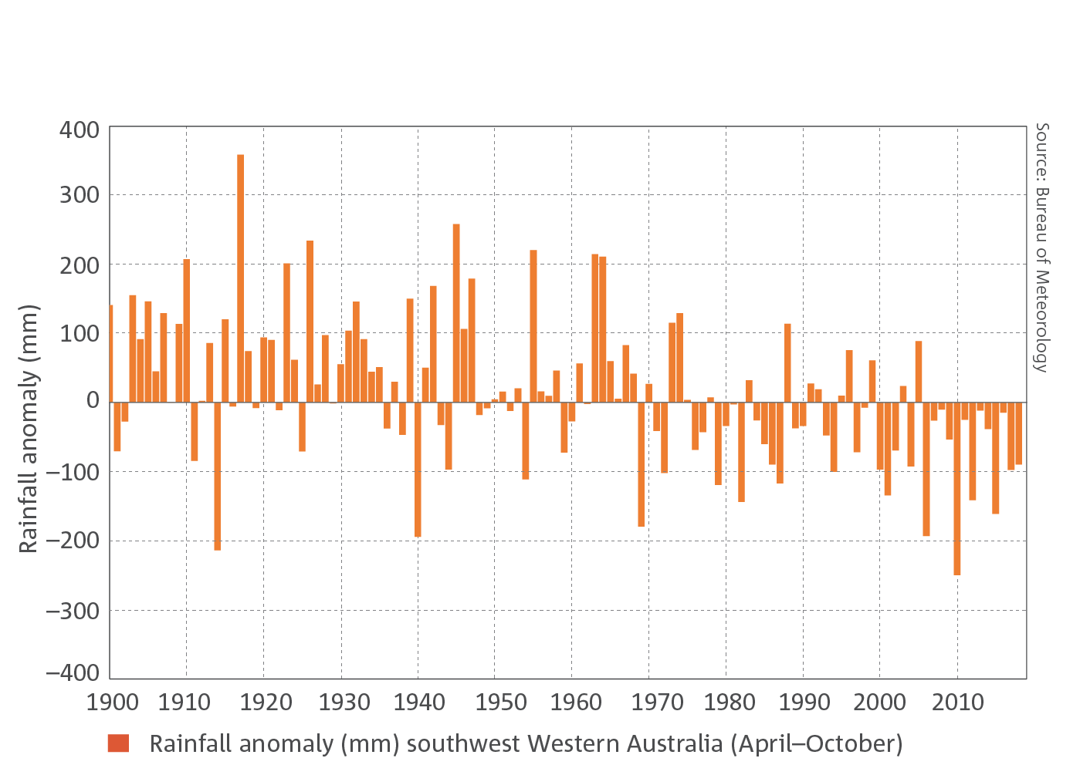
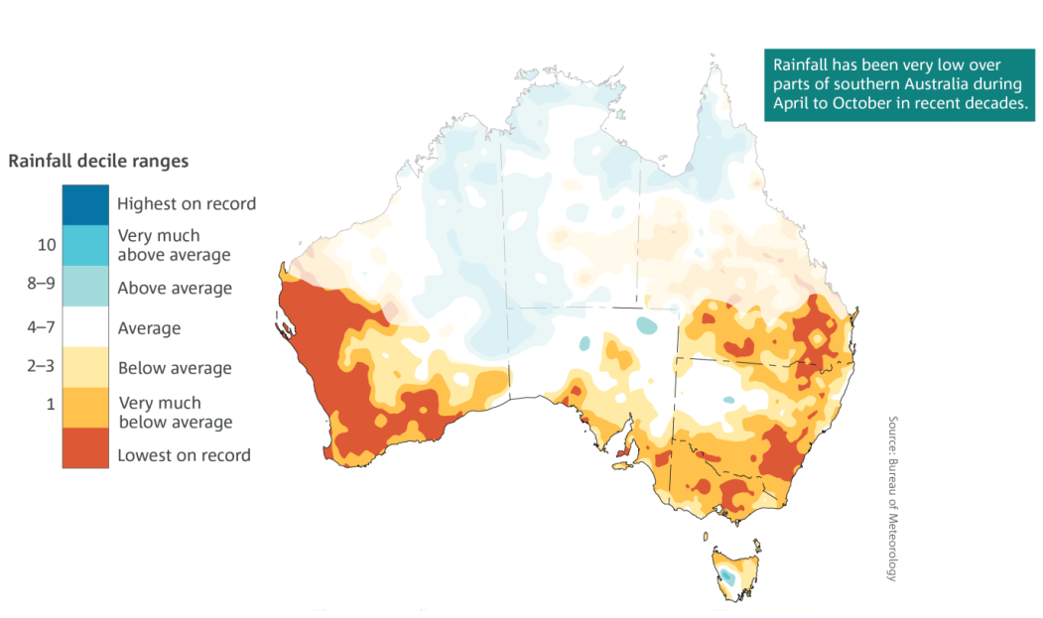
Less rain in the South West
Rainfall from Apr to Oct (winter/dry season) has decreased over the past 20 years, particularly in the South West
Source: CSIRO & Bureau of Meteorology, State of the Climate Report (2018)
w: health.wa.gov.au/climatehealthwa | e: climatehealthwa@health.wa.gov.au | t: @climatehealthwa

Slide 19
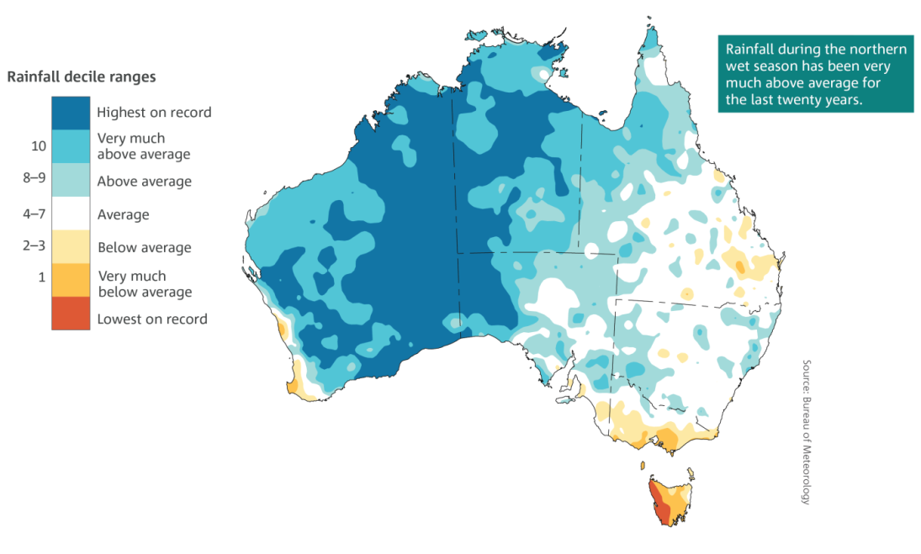
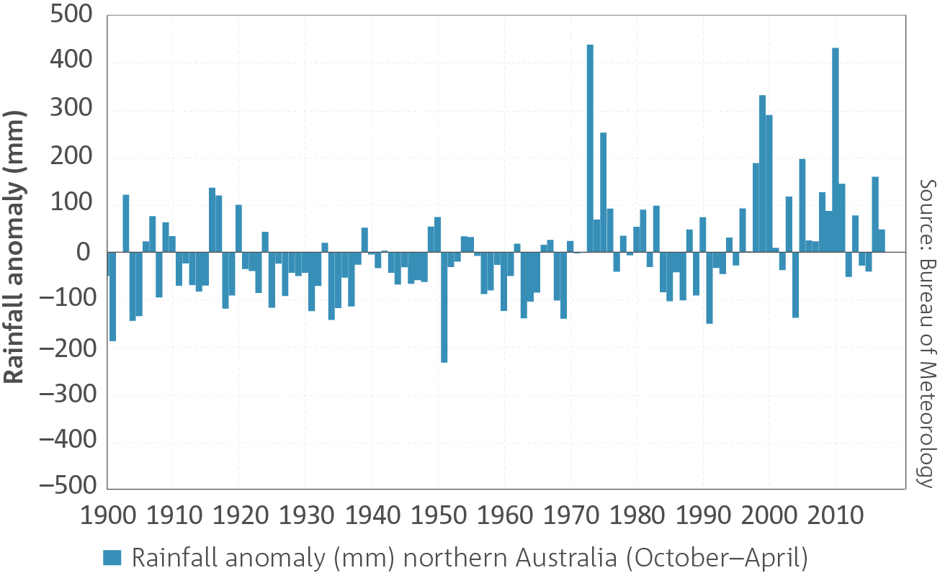
More rain in the north
Rainfall from Oct to Apr (summer/wet season) is increasing, except in Perth and the South West
The intensity of heavy rainfall is also increasing
Source: CSIRO & Bureau of Meteorology, State of the Climate Report (2018)
w: health.wa.gov.au/climatehealthwa | e: climatehealthwa@health.wa.gov.au | t: @climatehealthwa

Slide 20
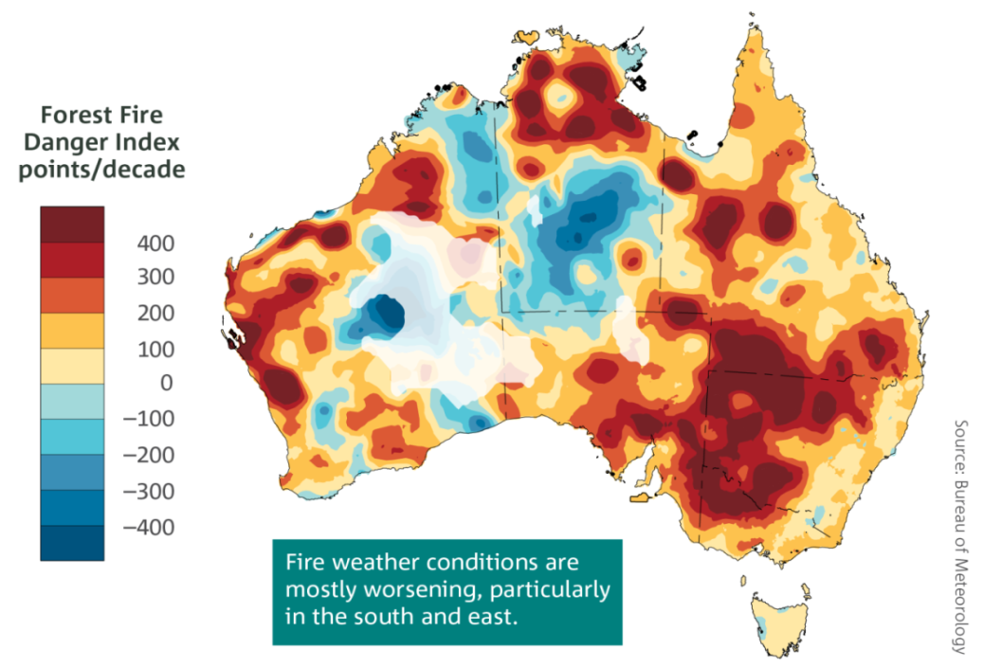
Impacts: heat, drought and fire
Increased frequency, intensity, duration and extent of heat waves
More time spent in drought (and hotter droughts)
Fire seasons longer and more intense
Source: CSIRO & Bureau of Meteorology, State of the Climate Report (2018)
w: health.wa.gov.au/climatehealthwa | e: climatehealthwa@health.wa.gov.au | t: @climatehealthwa

Slide 21
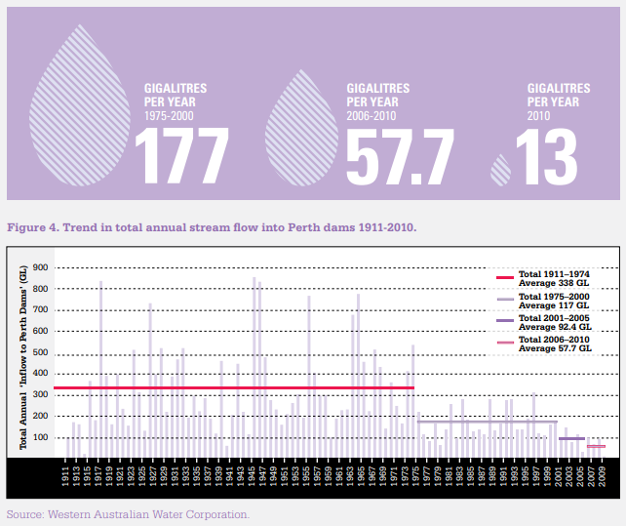
Impacts: fresh water
Less water into Perth dams
Source: Climate Commission, The Critical Decade (2013)
w: health.wa.gov.au/climatehealthwa | e: climatehealthwa@health.wa.gov.au | t: @climatehealthwa
Notes:
References: Climate Commission
The Critical Decade 2013: Climate Change Science, Risks and Responses
Climate Change Impacts for Western Australia
Available from: https://www.climatecouncil.org.au/resources/climate-change-impacts-for-western-australia/
Accessed: 25 July 2019

Slide 22
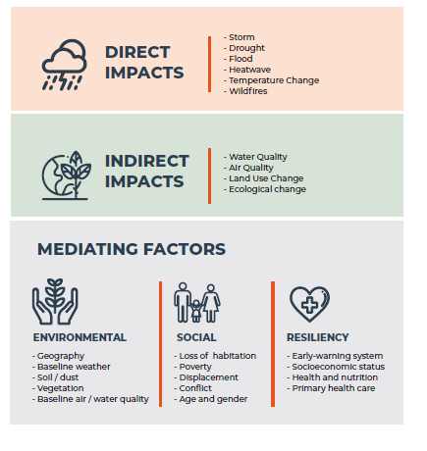
Climate change and health
Climate change is closely associated with human health
Effects increase with increased exposure
People differ in vulnerability
Source: COP24 Special Report – Health and Climate Change (2018)
w: health.wa.gov.au/climatehealthwa | e: climatehealthwa@health.wa.gov.au | t: @climatehealthwa
Notes:
Reference: World Health Organization
COP24 Special Report – Health and Climate Change
Available from: https://www.who.int/globalchange/publications/COP24-report-health-climate-change/en/
Accessed: 26 July 2019

Slide 23
Other health effects
Air quality
Reduced food and water quality
Changes in infectious agents
Population displacement
Food, water and vector borne disease
Mental health consequences and stress
w: health.wa.gov.au/climatehealthwa | e: climatehealthwa@health.wa.gov.au | t: @climatehealthwa

Slide 24
Deaths attributed to direct effects of heat in Australia
Natural Hazard | Deaths 1900-2011
Extreme heat | 4,555
Flood | 1,890
Tropical cyclone | 1,234
Bush/grassfire | 965
Lightning | 192
Wind storm | 140
Landslide | 95
Tornado | 55
Hail storm | 18
Earthquake | 16
Rain storm | 12
Source: Coates et al. (2014)
w: health.wa.gov.au/climatehealthwa | e: climatehealthwa@health.wa.gov.au | t: @climatehealthwa
Notes:
Reference: Coates L, Haynes K, O’Brien J, McAnerney J, Dimer de Oliveira F.
Exploring 167 years of vulnerability: an examination of extreme heat events in Australia 1844-2010. Envsci [Internet]. 2014 June [cited 2019 Feb 19]; 42(12): 33-44. Available from: https://www.sciencedirect.com/science/article/pii/S1462901114000999

Slide 25
Conclusion
The science of climate change is real and measurable
The links between climate change and health are clear
People differ in their vulnerability to the effects of climate change
Each region in WA is affected differently by climate change
w: health.wa.gov.au/climatehealthwa | e: climatehealthwa@health.wa.gov.au | t: @climatehealthwa

